Slide 1
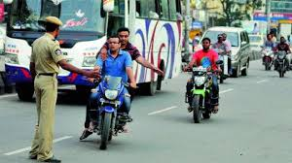
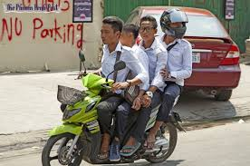
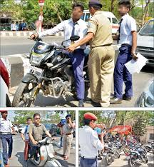
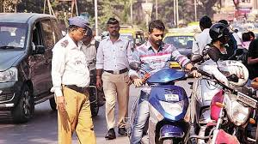
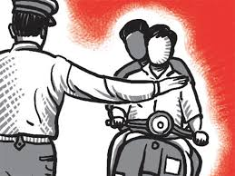

Slide 2
PROBLEMS
Increasing recklessness of citizens
Increasing accidents
Slow paced Challan System
Increasing deaths due to delay in medical aid

Slide 3
SOLUTION
Instant payment of challan.
Immediate help in case of accidents, robbery of vehicle.
Time to time notifications.
Strict vigilance to avoid road mishaps.

Slide 4
PRIMARY FUNCTIONS OF APP
To take input as a picture or as the vehicle number for which the challan will be generated.
To send a text message and a notification regarding the payment of challan.
To aid the driver to pay the challan through online payment.
To ease identification and notification in case of accidents.
To trace the missing vehicle.

Slide 5
User Domain

Slide 6
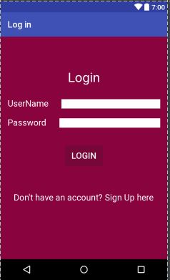
Login

Slide 7
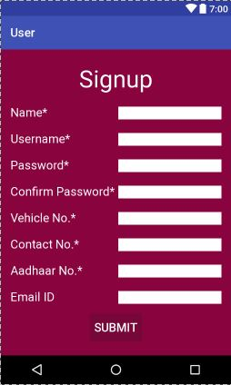
Sign Up

Slide 8
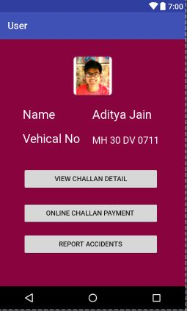
Profile

Slide 9
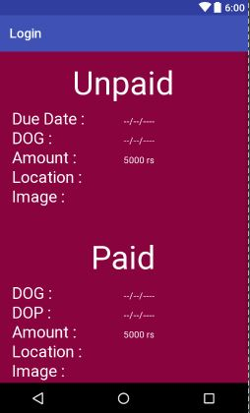
Challan Details

Slide 10
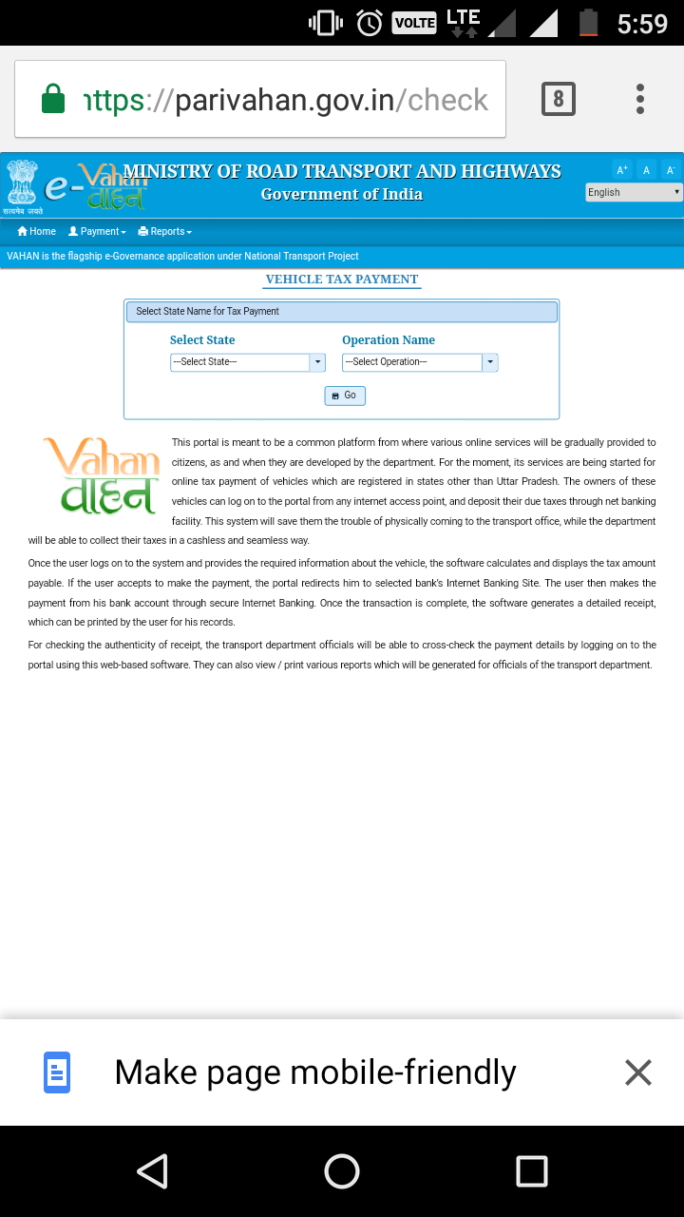
Payment Portal Parivahan

Slide 11
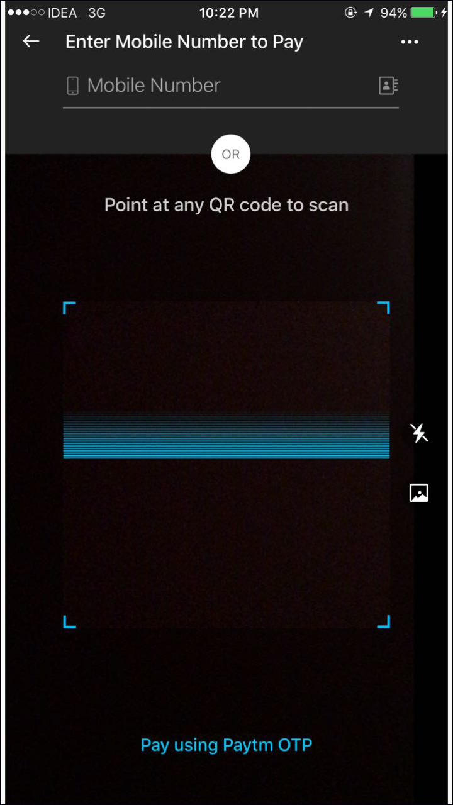
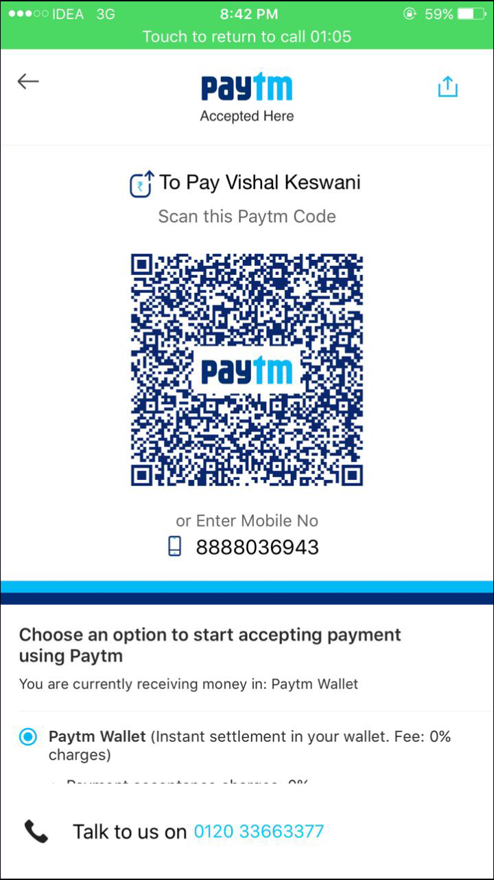
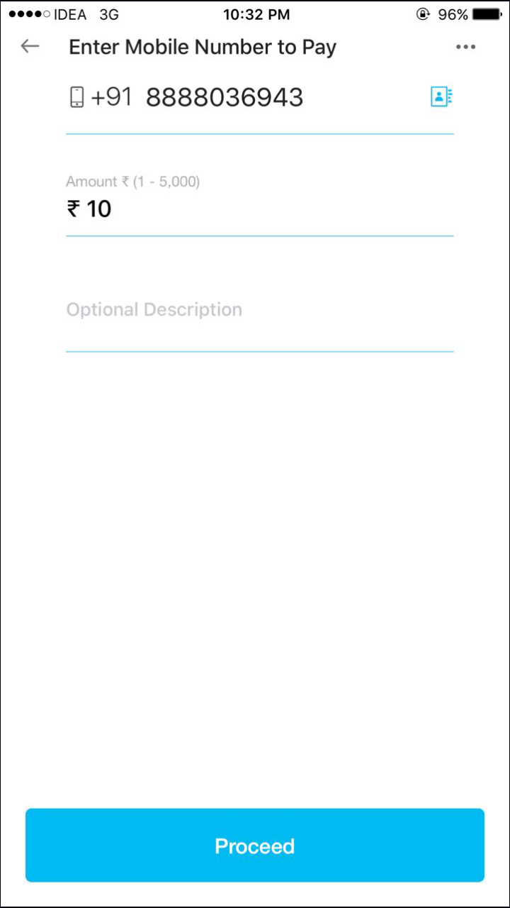
Payment Portal : Paytm

Slide 12
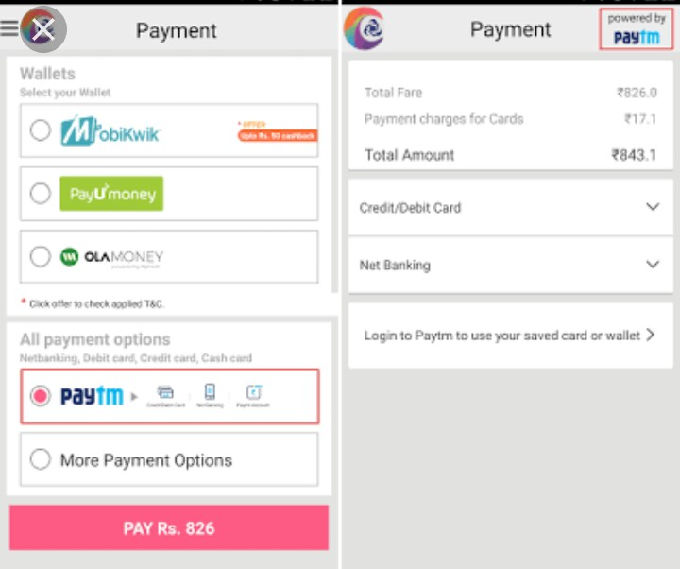
Payment Portal : Card Payment

Slide 13
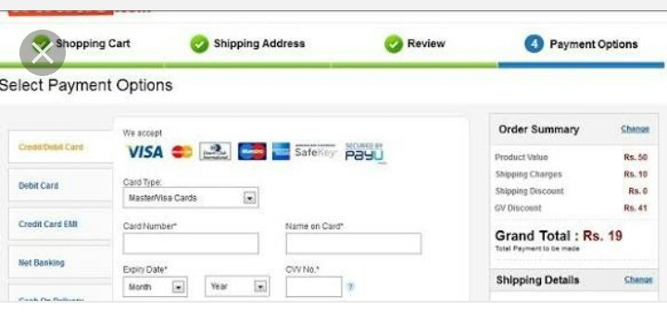
Payment Portal : Card Payment

Slide 14
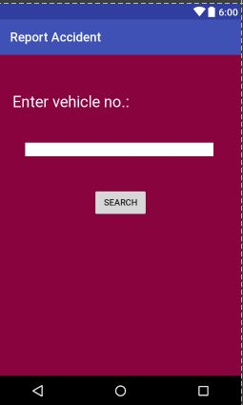
Report Accident

Slide 15
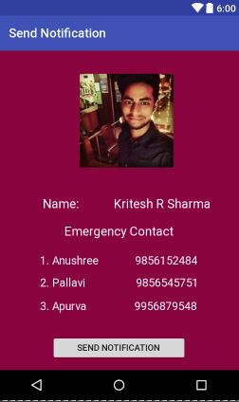
Send Notification

Slide 16
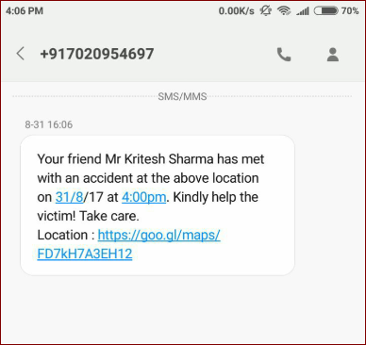
Text Message

Slide 17
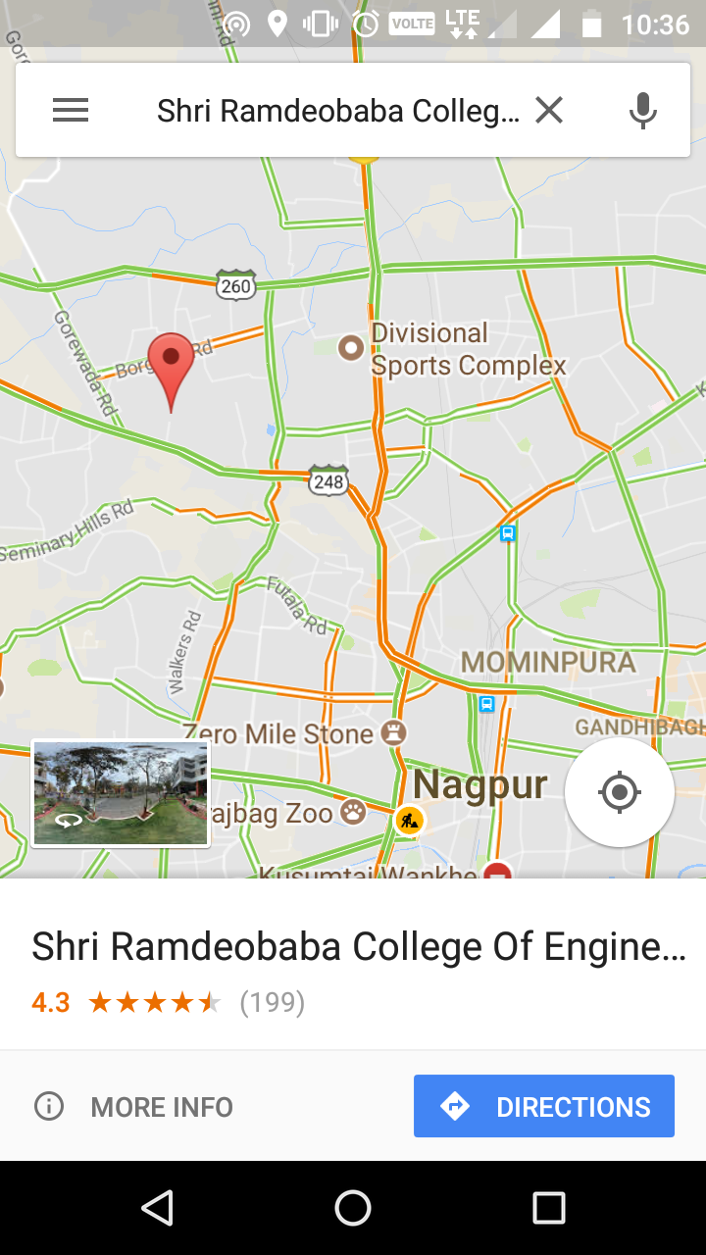
Location of Accident

Slide 18
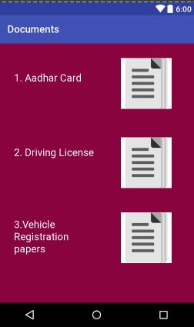
Documents

Slide 19
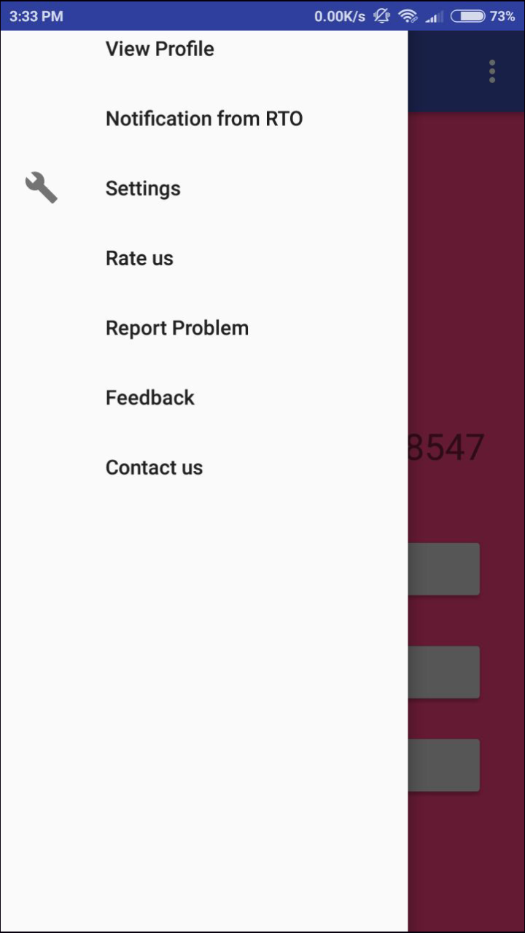
Navigation Drawer

Slide 20
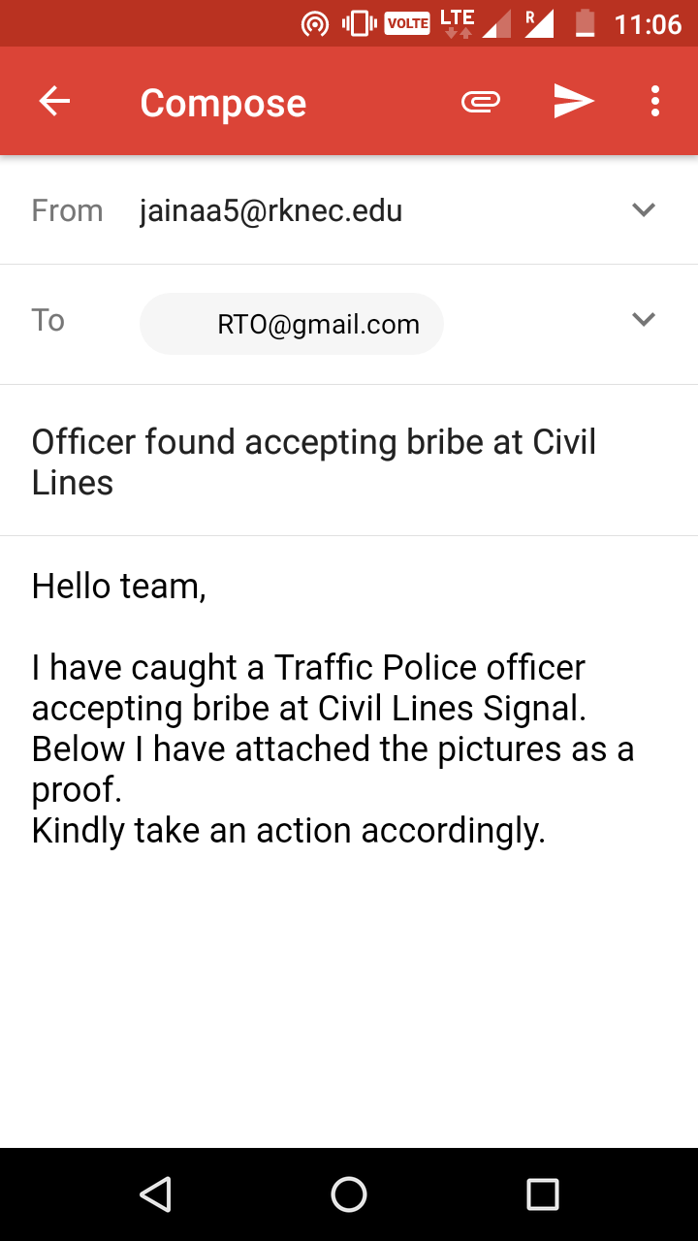
Report Problem

Slide 21
Police Domain

Slide 22
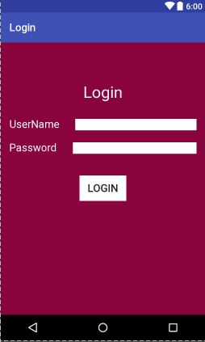
Login

Slide 23
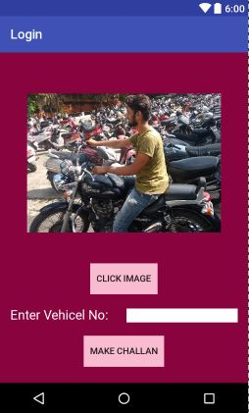
Generate Challan

Slide 24
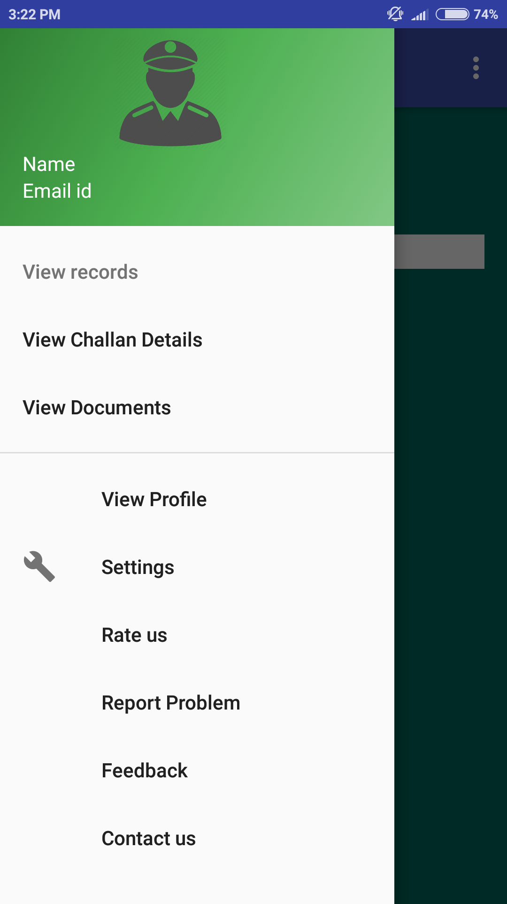
Navigation Drawer

Slide 25
View Challan Details

Slide 26
Navigation Drawer

Slide 27
View Documents

Slide 28
Navigation Drawer

Slide 29
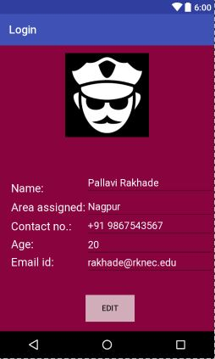
View Profile

Slide 30
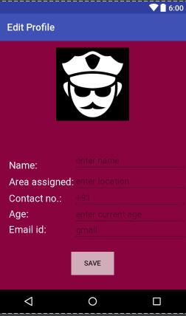
Edit Profile

Slide 31
ADVANTAGES

Slide 32
ONLINE CHALLAN PAYMENT
Convenient
Saves time
Paying challan online is safe and secure
Provide current paid and unpaid status of challan
Easy record keeping
Reduces documentations
Instant payment
Reduces corruption

Slide 33
DOCUMENT VERIFICATION
Ease to use
Faster
No need to carry all the documents
Anywhere anytime available
Reduce frauds
One database- many documents

Slide 34
REPORT ACCIDENTS
Immediate notifications
Immediate diagnosis
Avoids delay
No fear of police complaints
Family can take immediate actions

Slide 35
FUTURE SCOPE

Slide 36
Can maintain detailed history of a users vehicle and x-users
Tracking of vehicle
Dynamic duty allocation for policeman
Checking attendance through location
Check worked hours on particular places
Online vehicle registration
Graphical and statistical accidents reports

Slide 37


